Slide 1
Contract Signing Process
For Students Under 18
*You will need a parent/guardian to assist you with signing your contract*

Slide 2
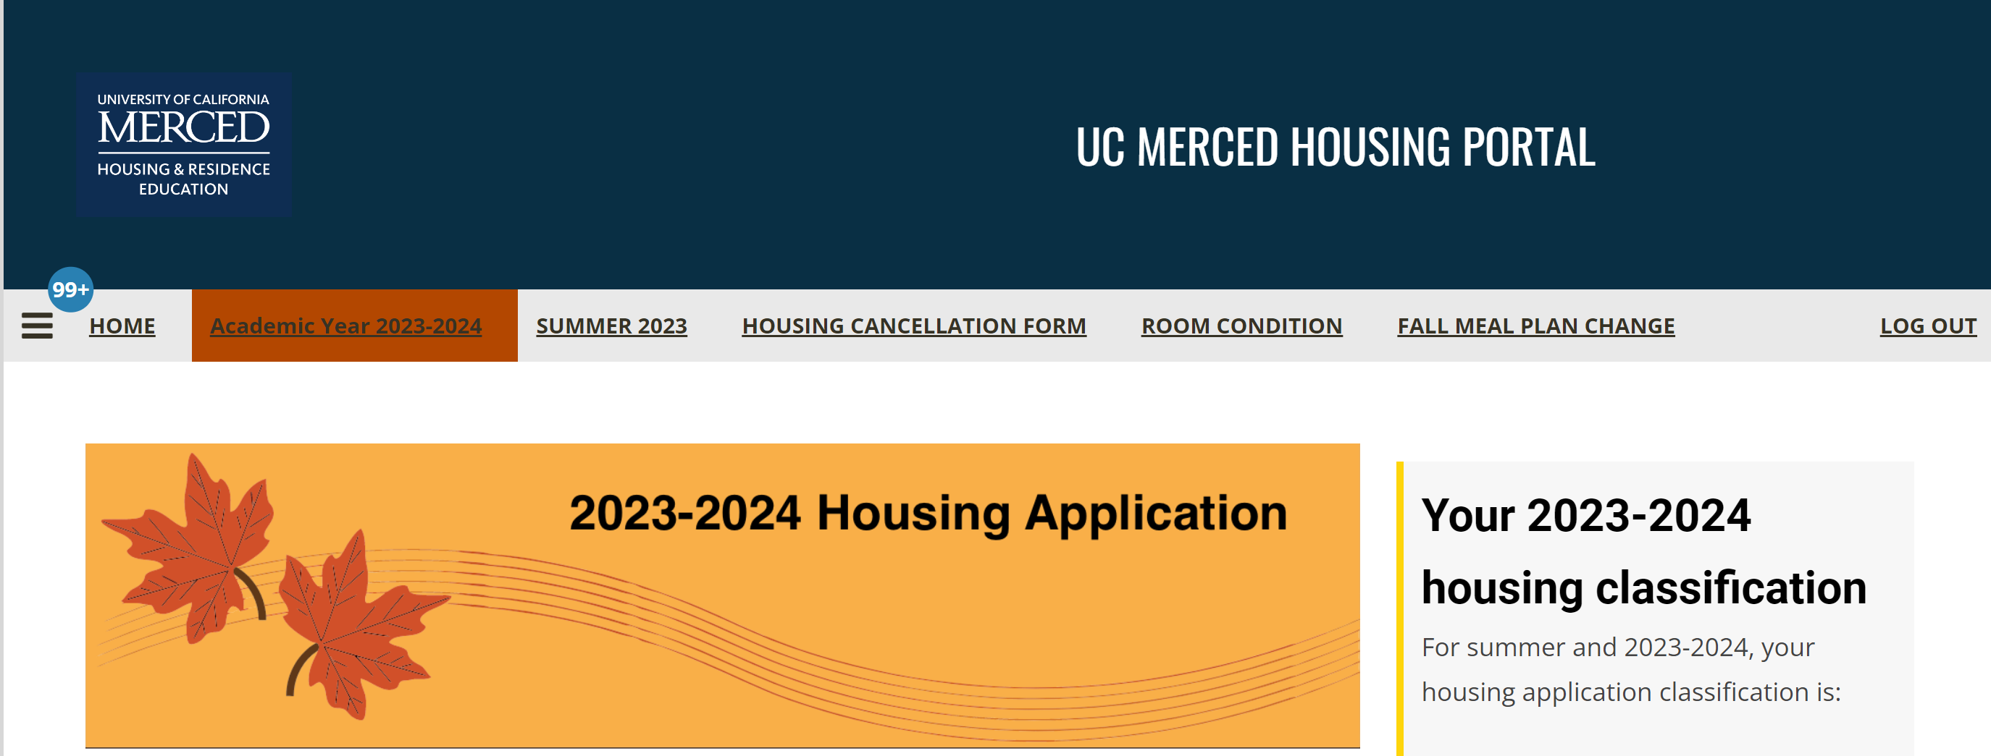
After your application has been accepted, you will receive an email on your UC Merced email named, "Housing Offer – Academic Year 2023-2024". You will log in to your housing portal and click "Academic Year 2023-2024"

Slide 3
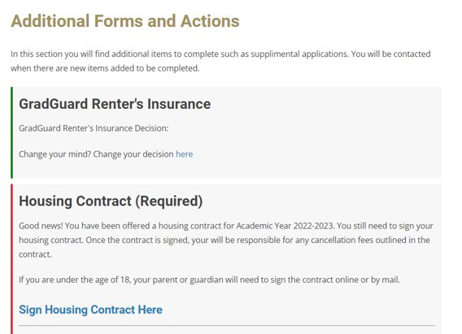
Once your application has been accepted, your application homepage will look like this Select "Sign Housing Contract Here" to begin the signing process

Slide 4
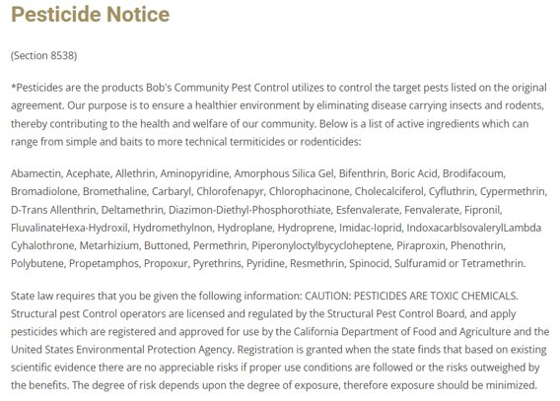
Pesticide Notice Read Through the Notice and then: 1. Sign Your Name 2. Click Save and Continue

Slide 5
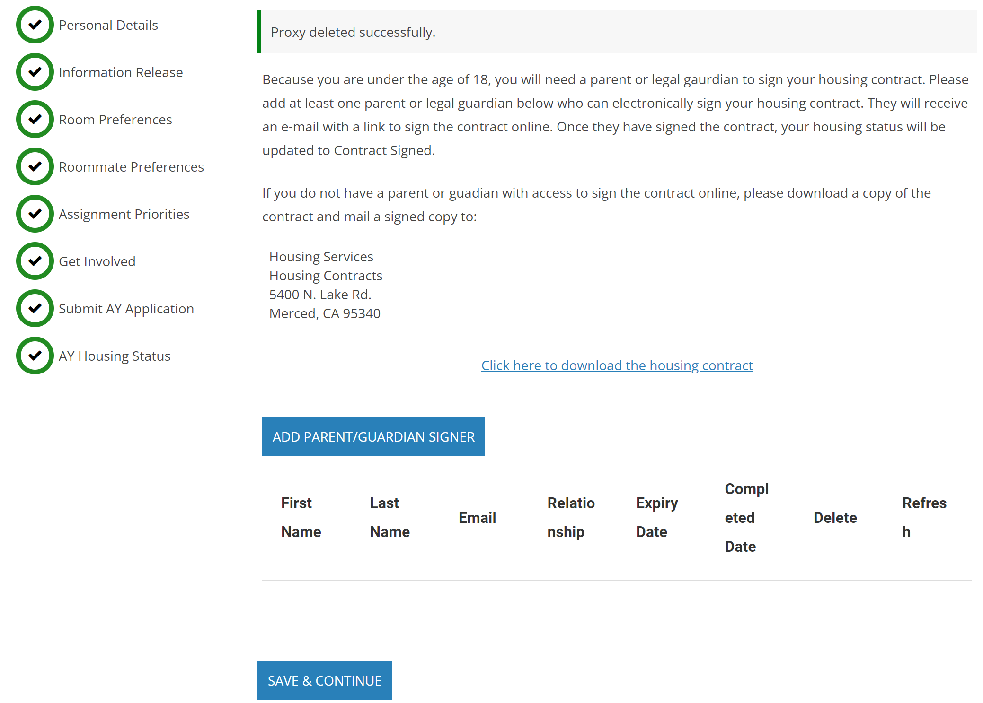
If you are UNDER 18, you will need a parent/guardian proxy signature Click the ADD PARENT/GUARDIAN SIGNER button.

Slide 6
Proxy Form 1. Enter Parent's first name 2. Enter Parent's last name 3. Enter Parent's email 4. Enter Parent's relationship to student 5. Create a pin so the parent can access the proxy form so they can sign

Slide 7
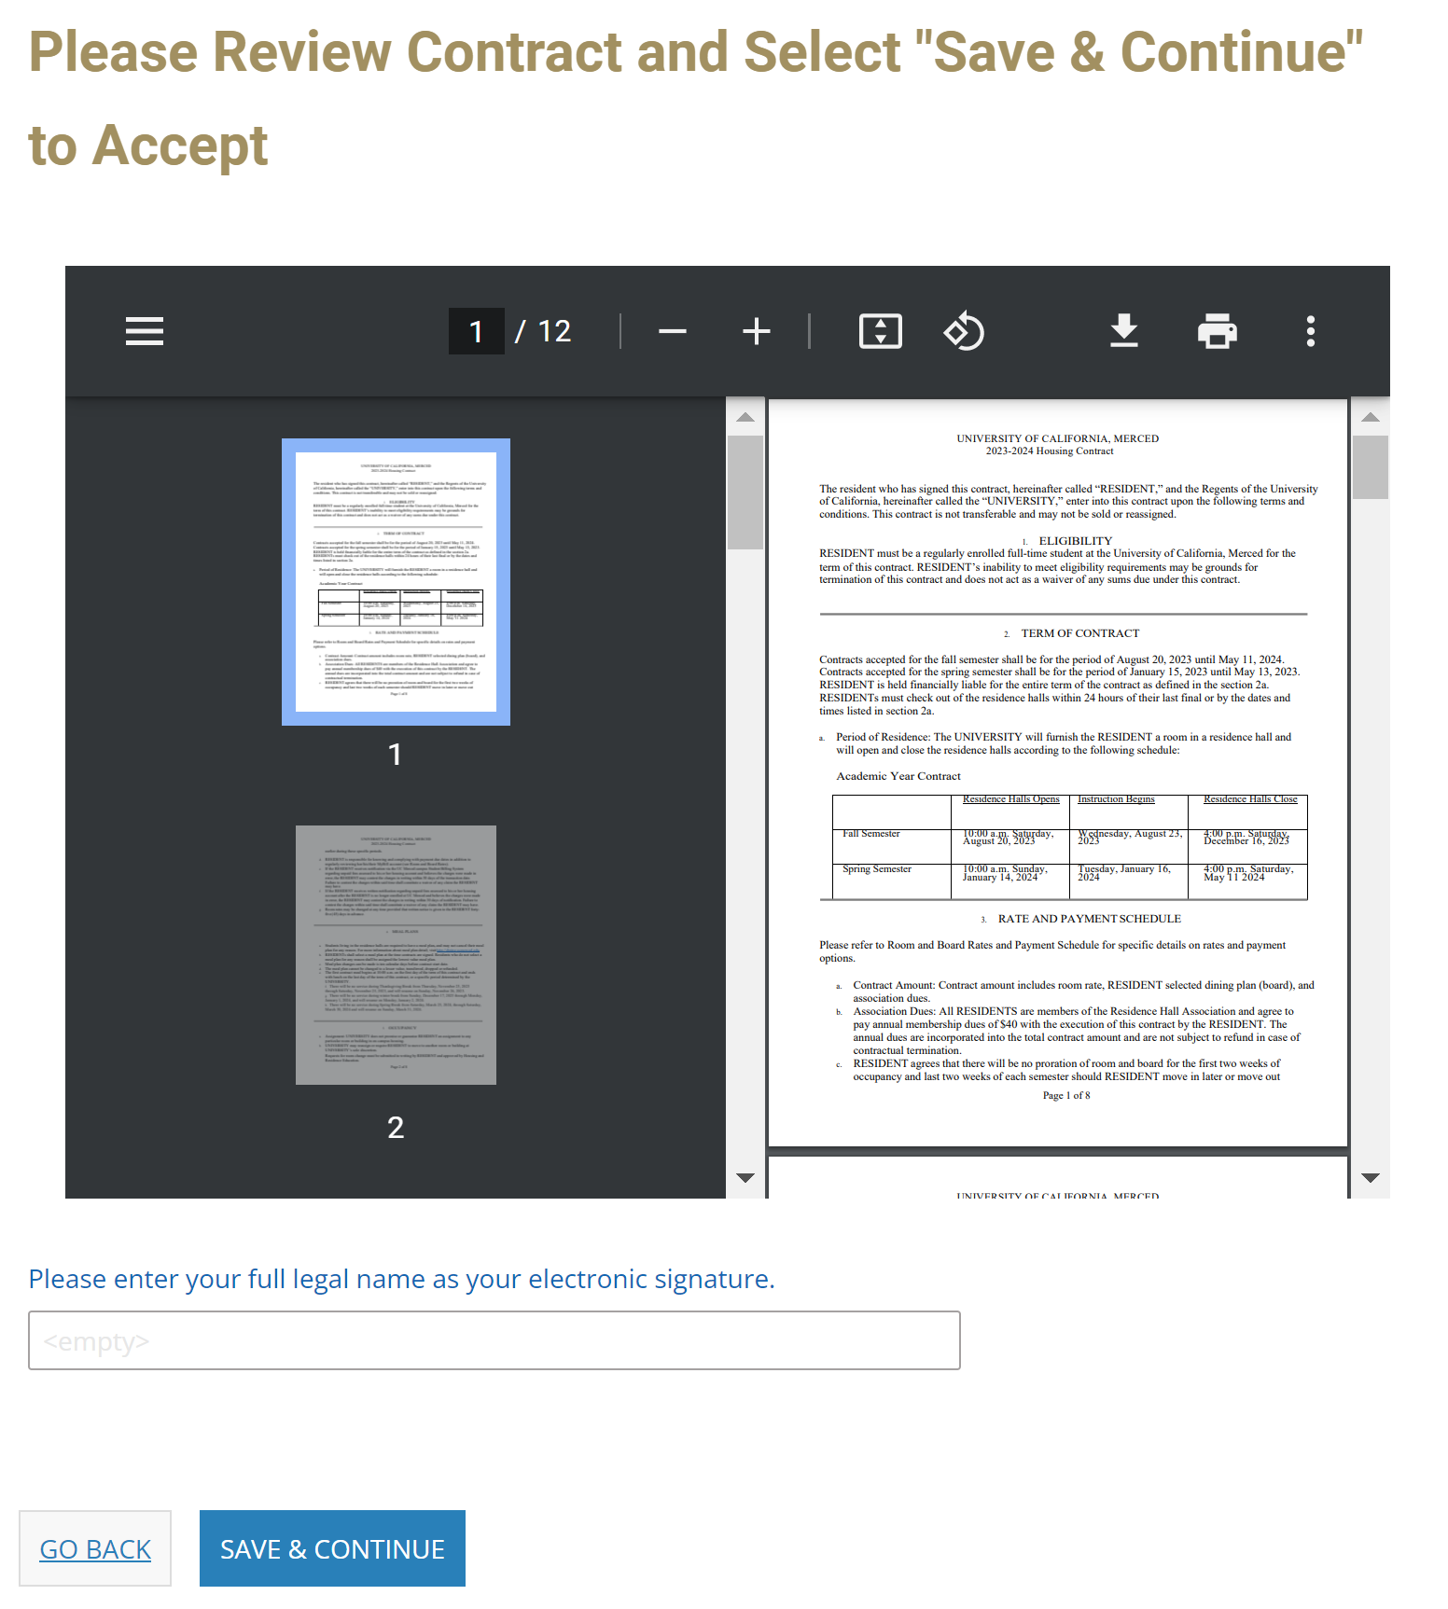
Electronic Signature At the bottom of page, enter student full legal name to electronically sign contract Click "Save and Continue"

Slide 8
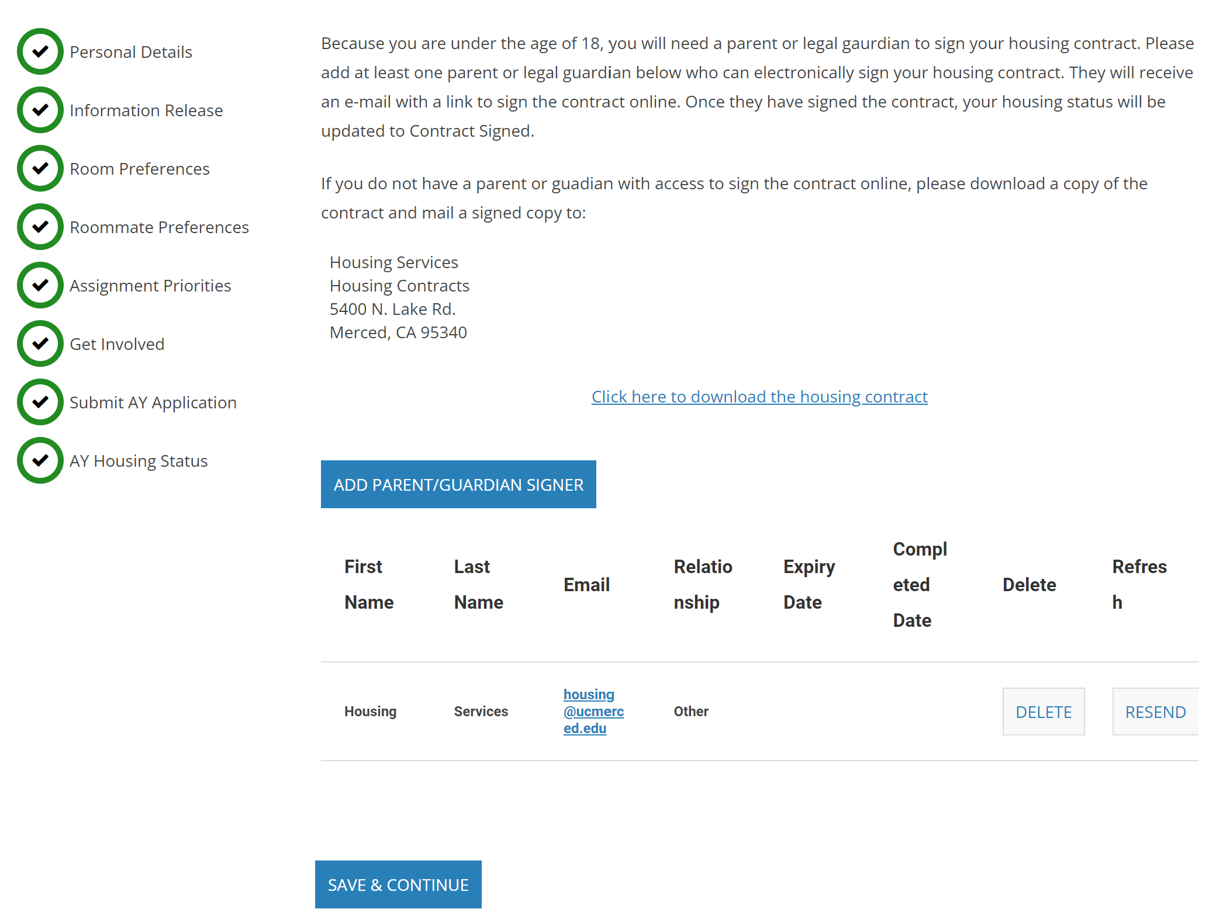
Now the Proxy Signature form has now been sent to the parent/guardian email.
They must access the email and click on the link "Please click to go to application"
Note: There is only a limited amount of time that this form will be open before the link will expire

Slide 9
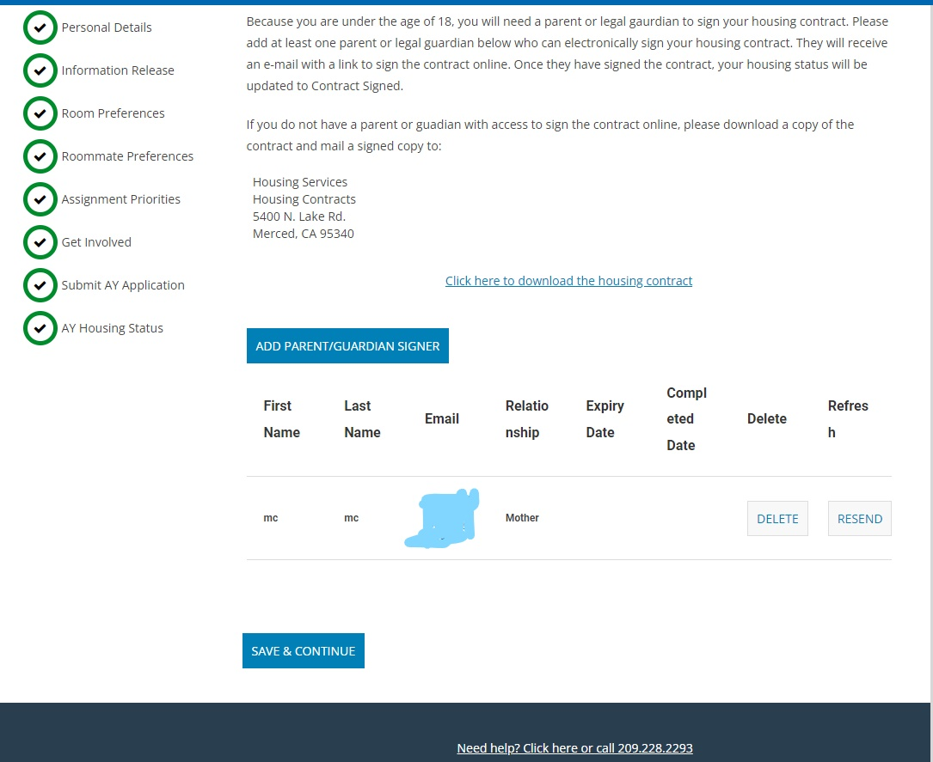
Now the Proxy Signature form has now been sent to the parent's email.
They must access the email and click on the link "Please click to go to application"
Note: There is only a limited amount of time that this form will be open before the link will expire

Slide 10
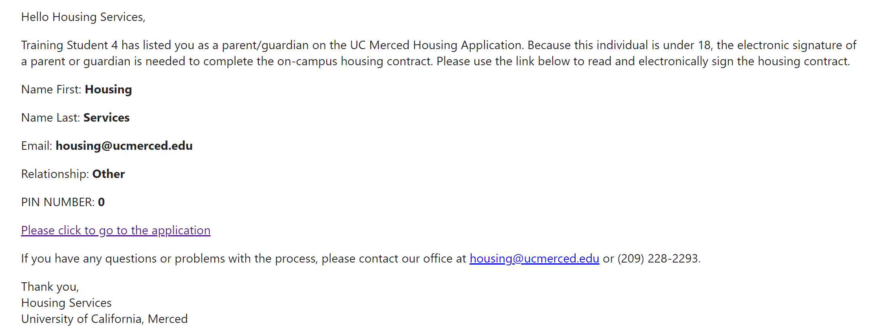
Parent Contract Sign Parents should have received the email by now to sign your contract
They must access the email and click on the link "Please click to go to application"
Note: There is only a limited amount of time that this form will be open before the link will expire

Slide 11
Next, select if you'd like to be a part of a Living Learning Community

Slide 12
If you do want to be a part of a Living Learning Community, you can add preferences for which community you want to be a part of

Slide 13
Read the Handbook and then you can agree to the Handbook and its policies by checking on "Handbook Agreement"

Slide 14
Next is information regarding Key and Access, sign the document at the bottom

Slide 15
Read about what GradGuard renter's insurance provides and click 'CONTINUE TO NEXT STEP'. This will bring you to a new page.

Slide 16
The new page should look like this. You may scroll down and read for more information. Continue to next slide.

Slide 17
Select whether you wish to purchase or decline coverage. Follow through the relevant popups and continue.

Slide 18
Finishing the GradGuard renter's insurance will bring you back to the housing portal page. Click 'Save & Continue' to progress in the contract signing process.

Slide 19
Click the dropdown menu to select your desired meal plan. Press 'SAVE & CONTINUE' after completing your selection.

Slide 20
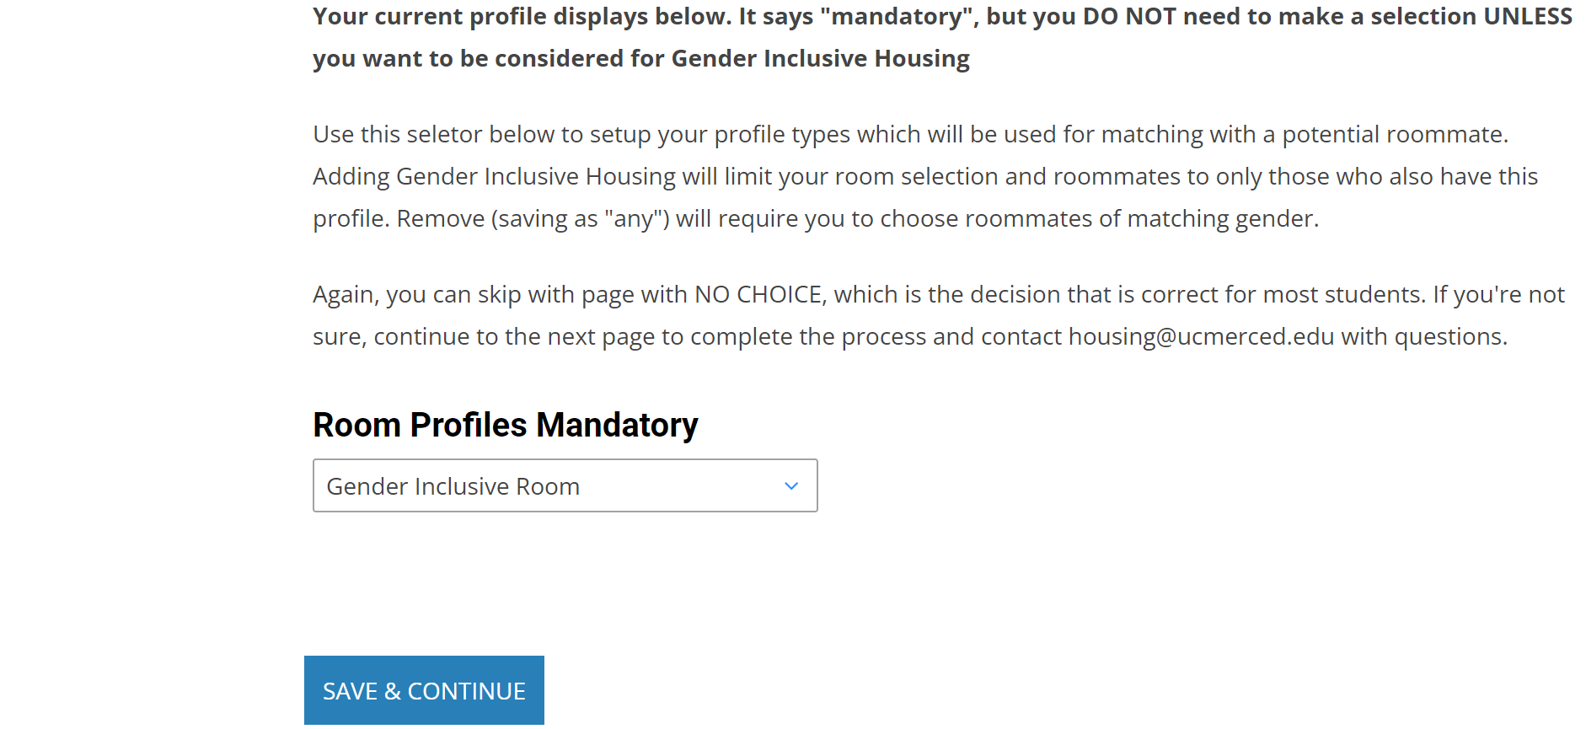
UC Merced offers Gender Inclusive housing. Please read through the provided information. Use the dropdown menu at the bottom of the page to opt in or opt out of gender inclusive housing. If choosing to opt out, please select '(Please select)'. Click 'SAVE & CONTINUE'

Slide 21
Make sure to open the link to start the Housing Contract Signing Process​
​
You're almost done!

Slide 22
Parent or Guardian Contract
The parents must now fill this section of the contract. ​
Parent/ Guardian enter : ​
First Name​
Last Name​
Email​
Select the relationship to student ​
Enter the PIN*​
NOTE*(This will be the PIN the student created when adding parent/guardian signer)

Slide 23
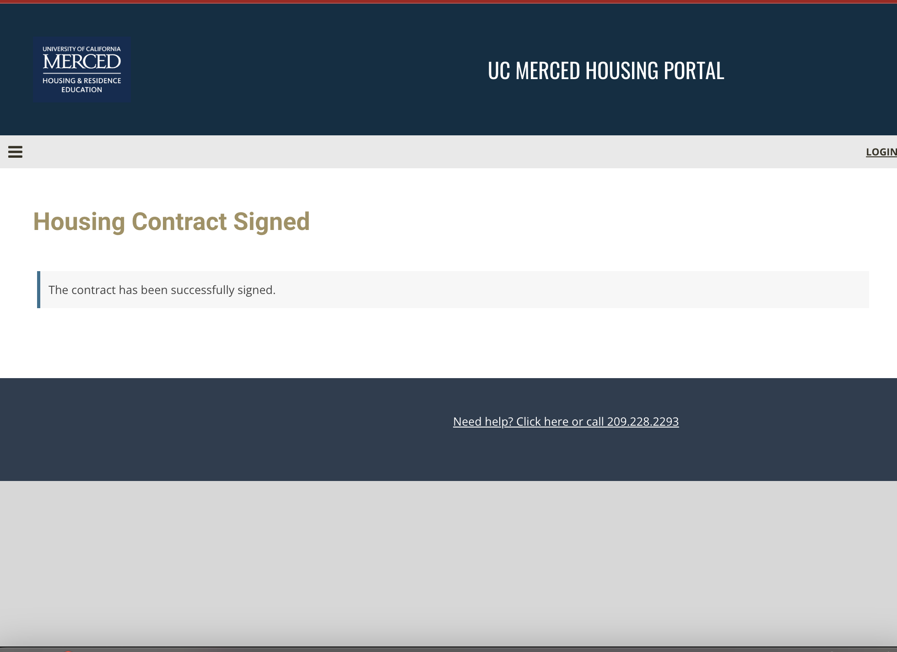
You have successfully signed your housing contract!

Slide 24
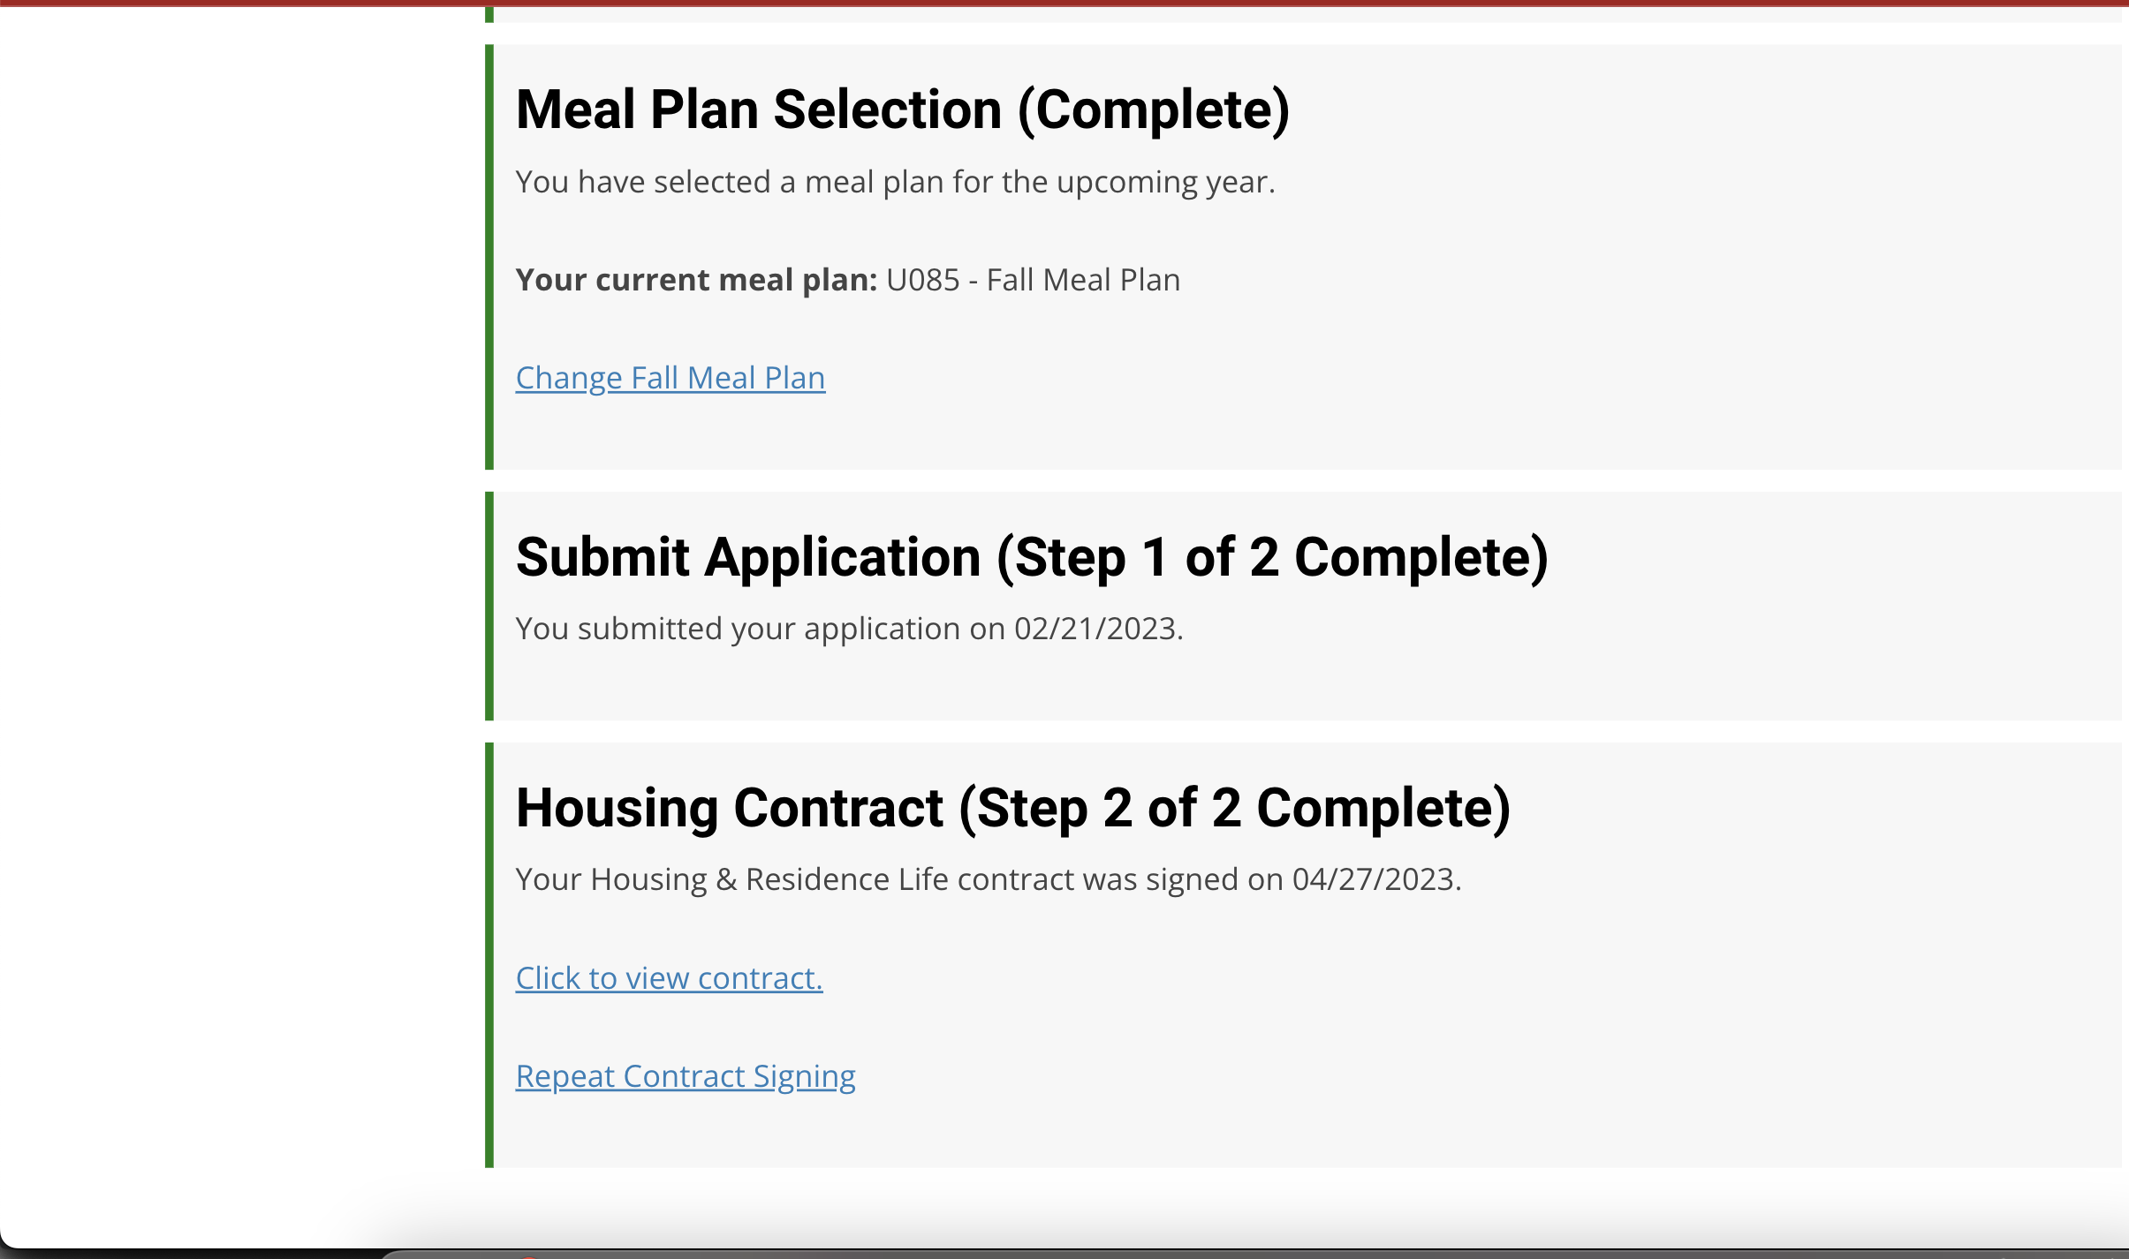
When all sections are green, Congrats! You're done!

